Slide 1
Social Media Analysis

Slide 2
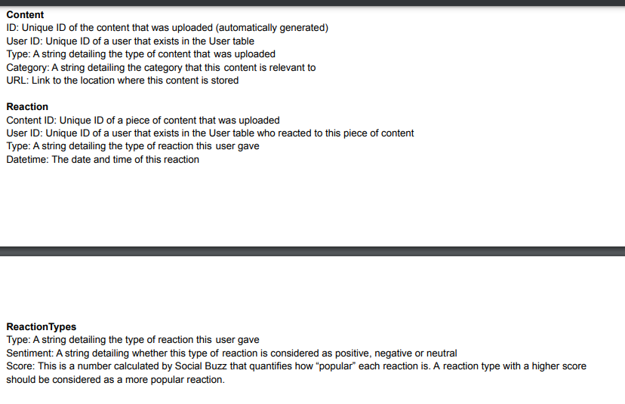
Data Model

Slide 3
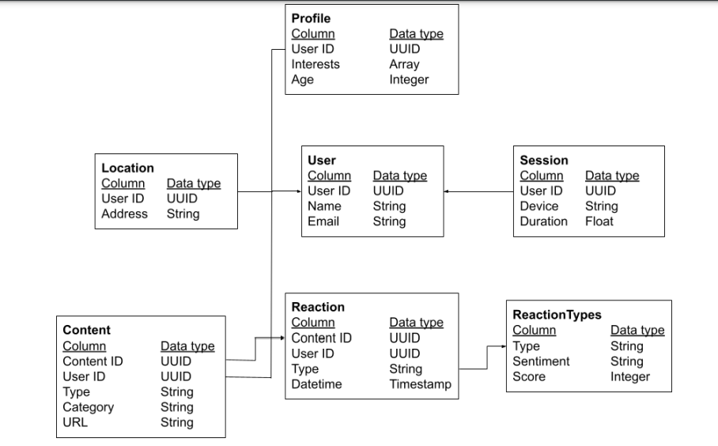
Original datasets

Slide 4
Data Cleaning
Removing unnecessary columns like url,Renaming Fields- changing type to Content Type
Changing the values in the rows to be consistent (like changing “Animals”, animals to animals)
Removing null reaction type rows in Reactions
Cmobing all three into one Final Data Set

Slide 5
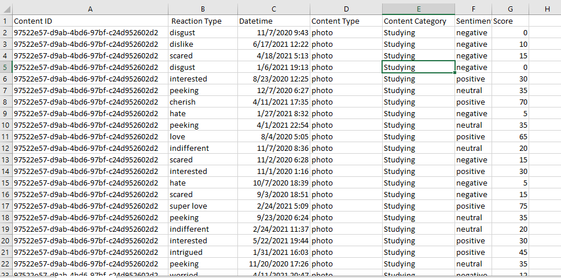
Create a final data set by merging your three tables together(Final Dataset)
using the Reaction table as base table, then first joined the relevant columns from Content data set, and then the Reaction Types data set using vlookup

Slide 6
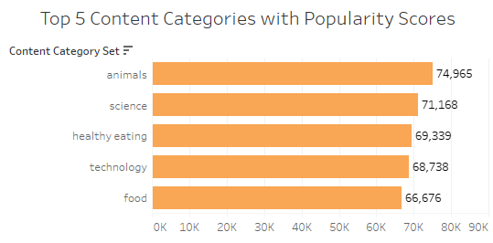
Top 5 Popular Categories

Slide 7
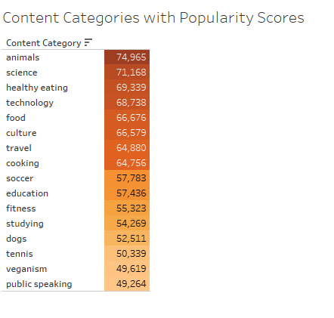
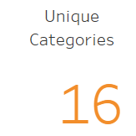
How many unique categories are there

Slide 8
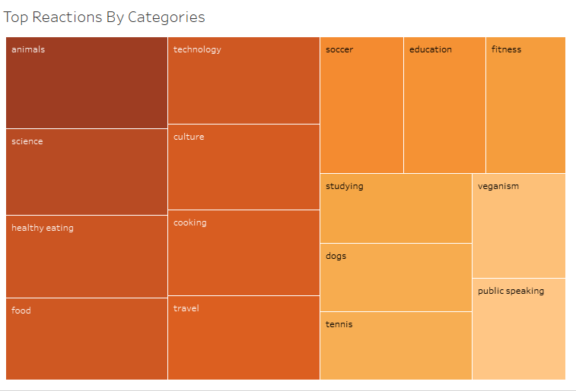
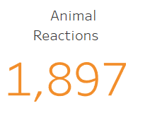
How many reactions are there to the most popular category

Slide 9
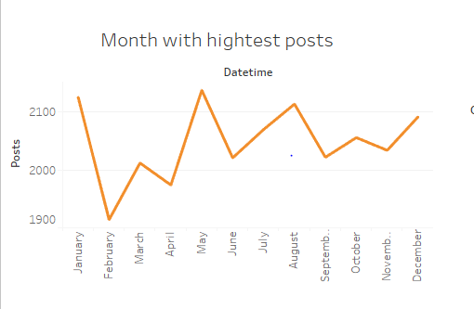
What was the month with most posts

Slide 10
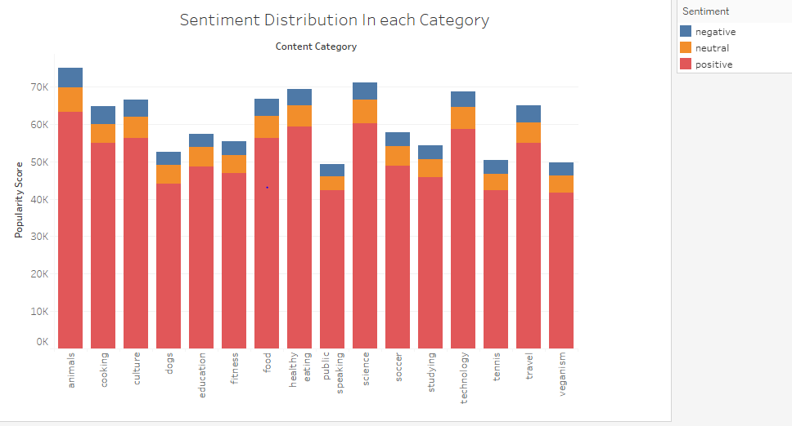
Sentiment Distribution by Category

Slide 11
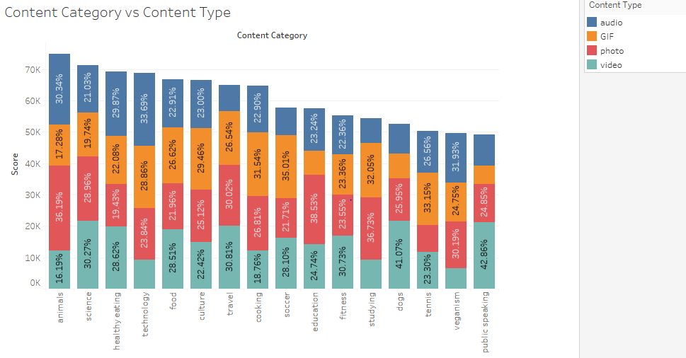
Percentage Share of Content Type by Categories

Slide 12
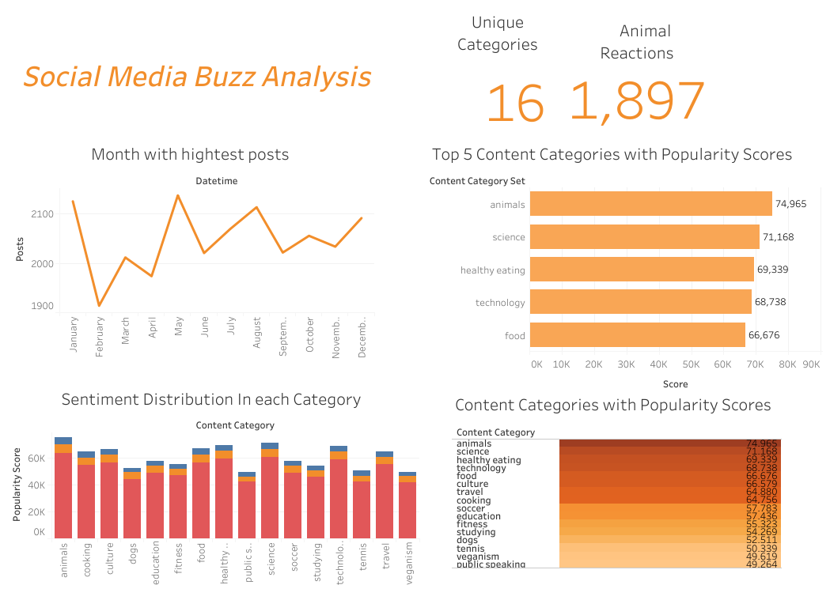
Final Dashbord (Click here)

Slide 13
Insights
Animals, Science, Healthy Eating, Technology and Food are top 5 most popular categories
There are total 16 categories of content
Animals category has the highest reactions
May has highest no of posts
Animals has the highest positive reactions
Photo Content type has the highest reactions

Slide 14
Recommendations
Encouraging posting animal content and Photo content will get more reactions
As healthy eating and food are in the top 5 categories, if we encourage more content with food and healthy eating wil grab more attention from users
More content can be encouraged in Summer months as people can share their vacation, Animal content on Social Media

